Slide 1

Follow the Beat
Marcelo Pereira
May/2022

Slide 2
Recommendation model
Nowadays, recommendation systems are present in the life of consumers. Those systems will recommend new products or services based on previous users' interactions or features of the products being offered. Using Spotify data, I explored 4 recommendation systems against tracks selected randomly.
4. Constraints within solution space
Reduced data sample compared to the universe of information that is available for the music industry
5. Stakeholders to provide key insight
Business leaders willing to improve the model of business by including data-driven decisions
6. Key data sources
API Spotipy:
https://spotipy.readthedocs.io/en/2.19.0/
https://developer.spotify.com/documentation/web-api/
1. Context
2. Criteria for success
3. Scope of solution space
The models are dedicated to songs suggestions and could be applied in any system with similar data available
Recommendation systems are present in e-commerce and streaming services. Even traditional businesses can take advantage of these models to improve the experience of their customers Using collaborative filtering, I created recommendation systems based on the tracks’ popularity, co-occurrence of artists, albums, and tracks
For each playlist, a part of the tracks was used as a seed to select the remaining, so they were compared to the ones previously existing in the playlist, then we counted the matches
Spotify users’ playlists were randomly selected to perform this task. I filtered only US users and playlists created between 2018-2021

Slide 3
Exploratory data analysis – extracted data
Exploratory data analysis raised some concerns about the data distribution overlapping for potable and non-potable
Basics
Quick Insights
Total playlists: 1,851 - Maximum tracks per playlist: 100
Total tracks: 140,248 - Unique tracks: 85,458
Average and median count of tracks per playlist: 75.8 / 98.0
Total artists: 28,669 - Artists/playlist: 15.5
Total albums: 62,095 - Albums/playlist: 33.5
Albums/Artist: 2.2
Playlists
48% of the playlists have 100 tracks
only 75 (4%) of them have less than 20 tracks, so we will remove these playlists from our analysis
Tracks
There are 85,458 different tracks
67,864 tracks (79.4%) appeared only one time
The track "Invisible" from the artists Andra and Lil Eddie is repeated 92 times
Artists
"Various Artists" is the most famous artist; however, this is not a relevant information
Drake is present in 877 playlists
15,609 artists (54.4%) appeared only one time
Albums
beerbongs & bentleys is the album that appeared in most playlists with 250 appearances
43,355 albums (69.8%) appeared only one time

Slide 4
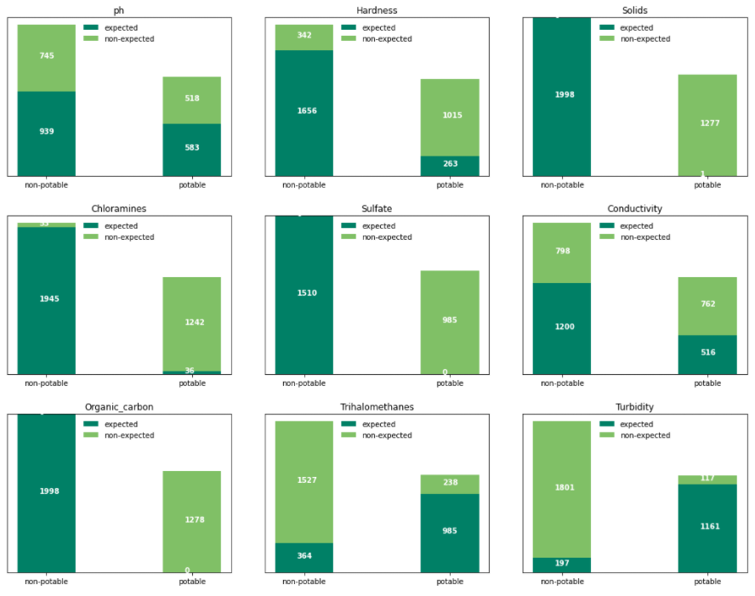
Target – potable and non-potable classification
Another aspect that seems off in the data is the correctness of the classification considering the expected values
Classification correctness
Data classification is not aligned to the WHO ranges for each parameter
Inconsistency present in all parameters and for potable and non-potable classes
Assumption: classification based on consumption in areas without alternatives

Slide 5
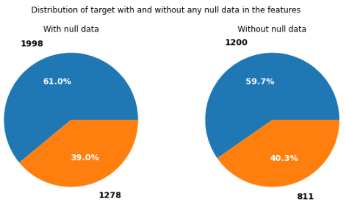
Modeling – data treatment
Missing values removed without any loss
Missing values
Data treatment
Missing data removed:
1265 rows excluded
2011 for the model data
No change in the target distribution
Training set:
70%
Testing set:
30%

Slide 6
Classifier, sampling, & scaling
6 classifiers with exploration of the parameters, 2 sampling methods, and 3 scaling techniques
Classifier:
Logistic Regression (Logit model): models the probability of well-defined classes or events (categorical) that can be binary or linear. Classification is the main application of this model.
K Nearest Neighbors (KNN): uses the distance between the values to group them, assuming that the data is similar when close.
Decision Tree: creates a set of rules to make the decision. These rules are evaluated and based on the decision, and you move to the following node till you reach the final classification (leaf).
Random Forest: consists of many individual decision trees that operate as an ensemble.
Ada-boost or Adaptive Boosting is an ensemble boosting classifier proposed by Yoav Freund and Robert Schapire in 1996. It combines multiple classifiers to increase the accuracy of classifiers.
XGBoost stands for eXtreme Gradient Boosting, which is a boosting algorithm based on gradient boosted decision trees algorithm.
Each model tested a set of parameters to define the best result.
Train/test sets sampling:
Random
Stratified
Results:
Random sampling led to slightly more accurate models than the Stratified.
Data scaling:
StandardScaler
MinMaxScaler
RobustScaler
Results:
No impact on the performance.

Slide 7
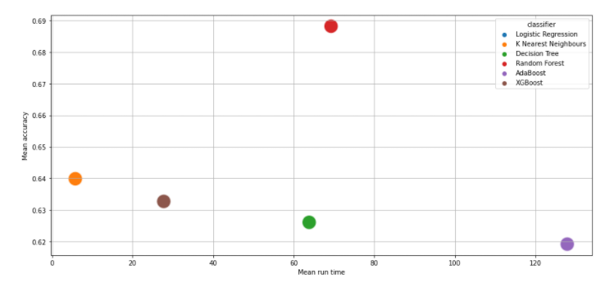
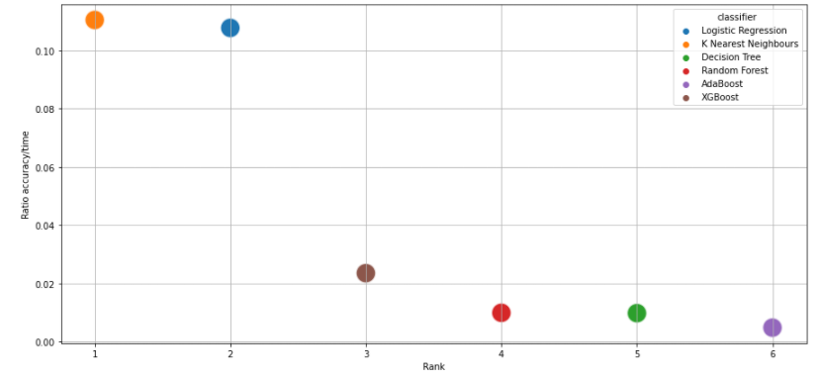
Modeling - results and analysis
Random forest is the winner evaluating the accuracy.
Accuracy
Ratio accuracy / run time
Random Forest
Random sampling
MinMaxScaler scaling
Accuracy 70%
Run time: 70 sec (training)
Parameters: ’min_samples_leaf’: 2 and ‘n_estimators’: 500
KNN
Accuracy (mean): 0.64
Faster run time does not justify the selection of this model with lower accuracy, once Random Forest run time is only 70 seconds.

Slide 8
Summary and conclusion
Models performed acceptably but data quality must be the considered carefully to adopt the model.
Considerations
Conclusion and alternatives
The model reached an accuracy acceptable of 70%
Data quality raises concerns and could be classified as unreliable data with poor quality.
Classification measured is discrepant with the expected classification.
All parameters have a heavy overlapping distribution for potable and non-potable.
The absence of correlation between parameters knowingly correlated, for example, the known correlation between pH and potability.
Physical properties of the water are good predictors of potability
Data available has a substantial discrepancy between the expected and the measured.
Classification measured should be revisited, or more information should be available to clarify the concerns.
Model should not be used as a predictor for water potability due to data quality issues.
Alternative solution: redo all the sampling and measurements or fix the classification in the data.

Slide 9




Contact:
Marcelo Pereira
https://www.linkedin.com/in/marcelo-alves-pereira/
map_fm@yahoo.com

